Slide 1
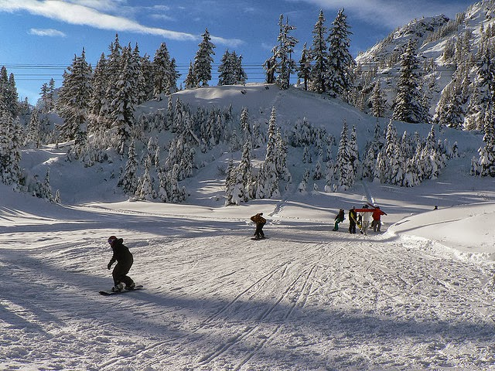
Big Mountain Resort
Feb. 4, 2024
This Photo by Unknown Author is licensed under CC BY

Slide 2
Agenda
Objective (slide 3)
Scenarios (slide 4-7)
Methodology (slides 8)
recommendations(slide 9)

Slide 3
Objective
Identify how Big Mountain Ski Resort capitalize its facilities and cut cost meanwhile increasing the value of ticket prices relative to its position in the market.
View scenarios to identify the best option for marginalizing its facilities,
Increasing price based on comparing facilities in the same market segment.

Slide 4
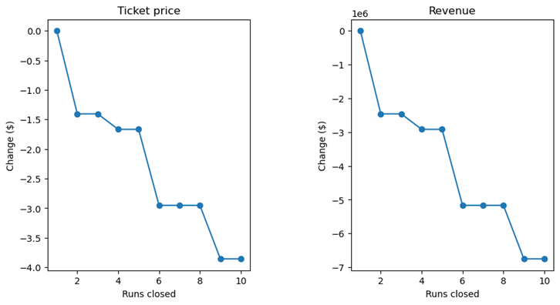
Scenarios
Option 1:
Compared potential scenarios for either cutting costs or increasing revenue from ticket prices for closing at least 10 least used runs.

Slide 5
Scenarios
Option 2:
Increase the vertical drop by adding a run to a point 150 feet lower down but requiring the installation of an additional chair lift to bring skiers back up, without additional snow making coverage.
Key finding:
•This scenario increases support for ticket price by $1.00, which could be an expected revenue of $1750000 over the season.

Slide 6
Scenarios
Option 3:
Increase the vertical drop by adding a run to a point 150 feet lower down but requiring the installation of an additional chair lift to bring skiers back up and adding 2 acres of snow making cover.
Key finding:
No difference to support a price increase was supported by adding additional operating cost of snow making coverage.

Slide 7
Scenarios
Option 4:
Increase the longest run by 0.2 mile to boast 3.5 miles length, requiring an additional snow making coverage of 4 acres.
Key Findings:
No difference in price to support:
Adding additional cost by increasing the longest run by 0.2 miles
Or adding additional expense of snow coverage to 4 acreage .

Slide 8
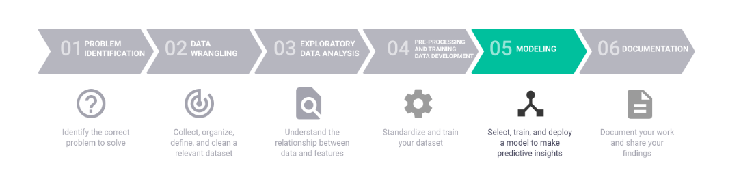
Methodology
The Data Science Method was used to compare the other resorts in the same market segment against Big Mountain.

Slide 9
Recommendations
Option 2 offered the best results to support for ticket price by $1.00, which could be expected to amount to $1750000 for the season.
Marketing teamwork continue testing the parameters utilized and determine other factors to consider to better define the model.

